Slide 1
“Enhancing Combined-Cycle Power Plant Performance”
Predictive Modeling of Energy Production
1.HEMALATHA VADLA
2.NABEEL KHAN
3.BIVIN B
4.VIJAYALAXMI GANGADE
5.REHAMAN SHAIK
6.SREE SNEHITHA

Slide 2
Business Objective:
Optimize the combined-cycle power plant's performance by modeling energy production as a function of exhaust vacuum and ambient variables.
Importance: Enhancing efficiency and reliability in electricity generation.

Slide 3
Combined-Cycle Power Plant:
Components: Gas turbines,
steam turbines,
heat recovery steam generators.
Electricity Generation: Gas and steam turbines combined in one cycle.
Objective: Model energy generated by understanding exhaust vacuum and ambient variables.

Slide 4
Data Set Details:
Source: Combined-cycle power plant observations over six years.
Size: 9568 observations with five variables.
Variables:
Temperature (°C)
Exhaust Vacuum (cm Hg)
Ambient Pressure (millibar)
Relative Humidity (%)
Energy Production (MW)

Slide 5
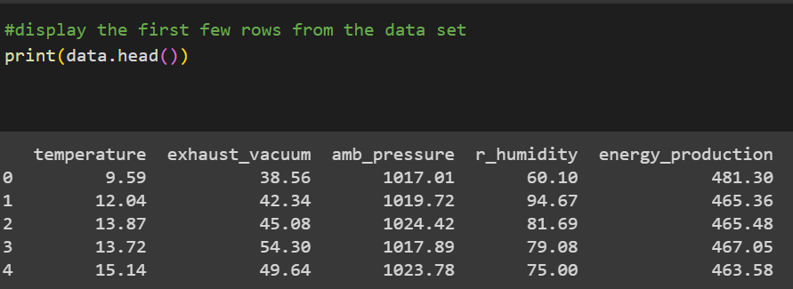
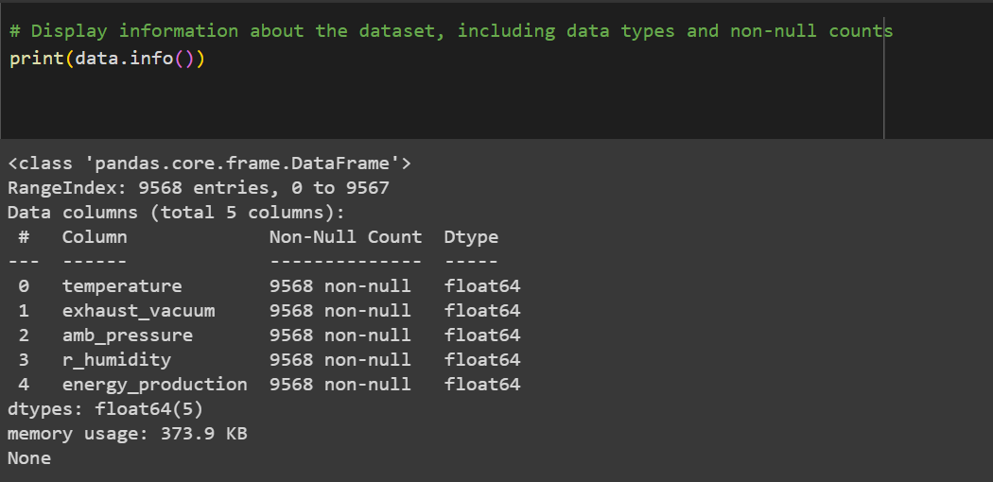
Exploratory Data Analysis (EDA)
Independent Variables:
Temperature in degrees Celsius
exhaust_vaccum ,in cm Hg
amb_pressure ,in milibar
r_humidity ,in percentage
Dependent variable:
energy_production ,in MW ,net hourly electrical energy output.
Null values:
There are no null values in the entire data set.

Slide 6
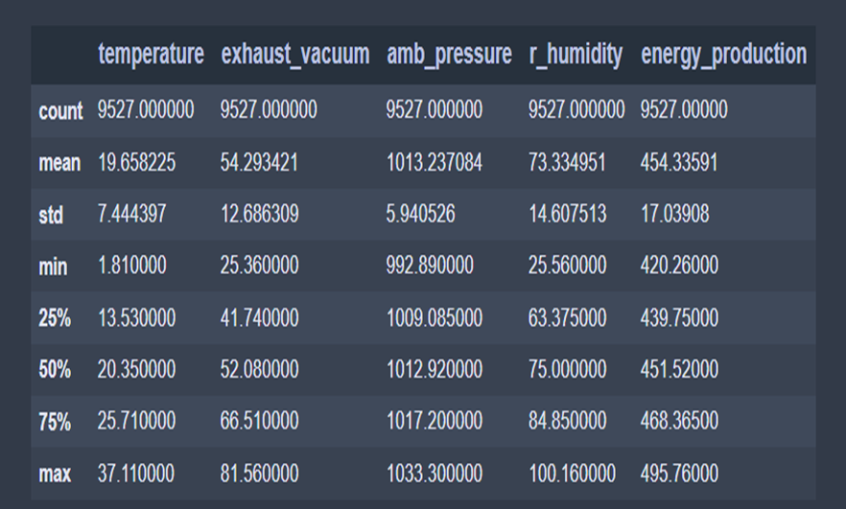
Descriptive Statistics :
The average Energy Produced by the power plant is about 454 MW per Hour with Standard Deviation of 17 MW per Hour

Slide 7
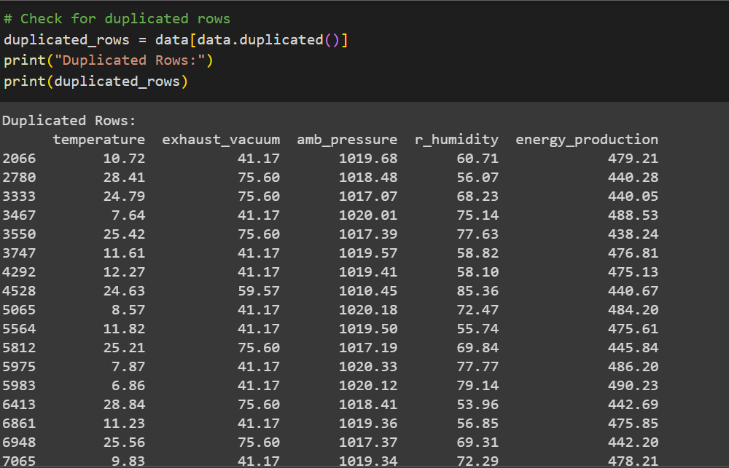
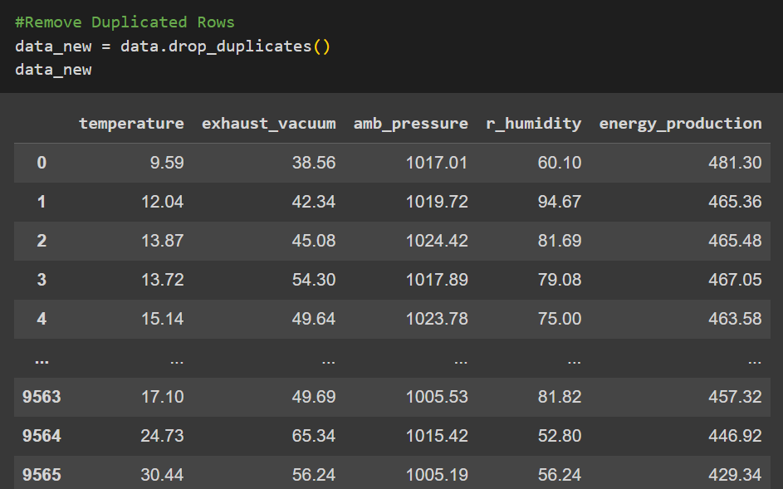
Removing the Duplicated rows

Slide 8
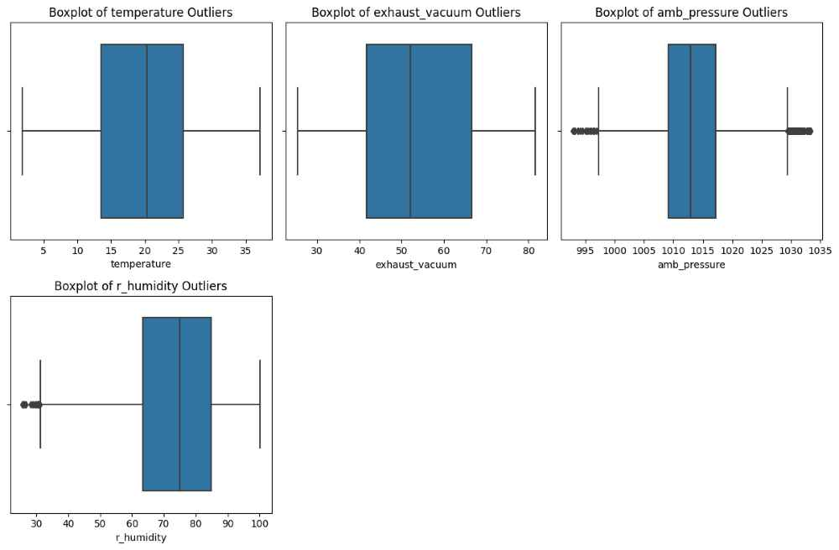
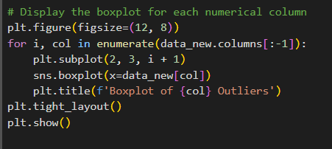
Outlier Analysis
Boxplots showing
outliers Before
Removal

Slide 9
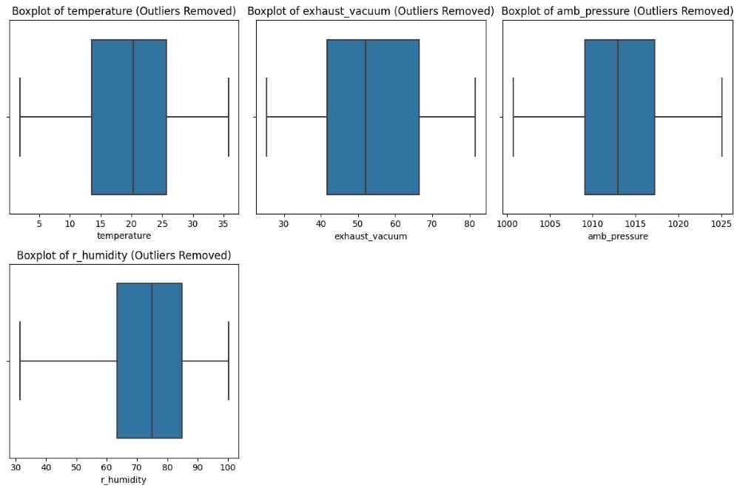
Boxplot after removal of outliers
'''deciding whether to delete or modify the outliers requires careful consideration our amb_pressure have 30% outliers so lets modify the data rather than the deleting because it may contains the valuable information '''
'''Winsorizing involves replacing extreme values with a specific threshold value.
This limits the influence of outliers without removing them completely.
There are several ways to modify outliers in your data''

Slide 10
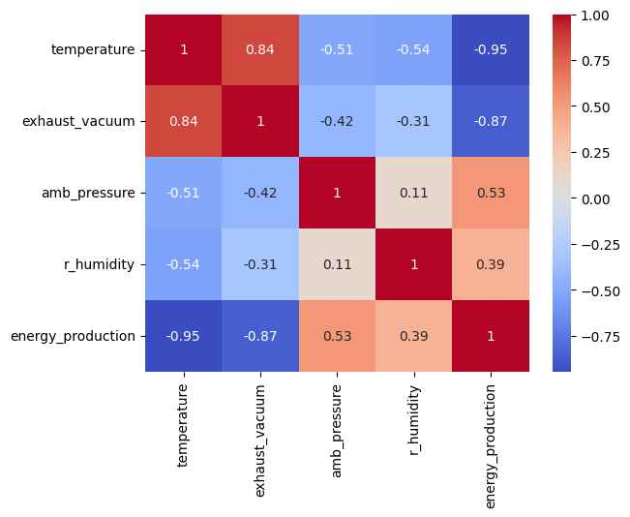
Correlation
Heatmap
It helps to quickly identify realtionships between variables by displaying correlation coefficients .
The Red colour indicates the positive correlation .
The Blue colour indicates the negative correlation

Slide 11
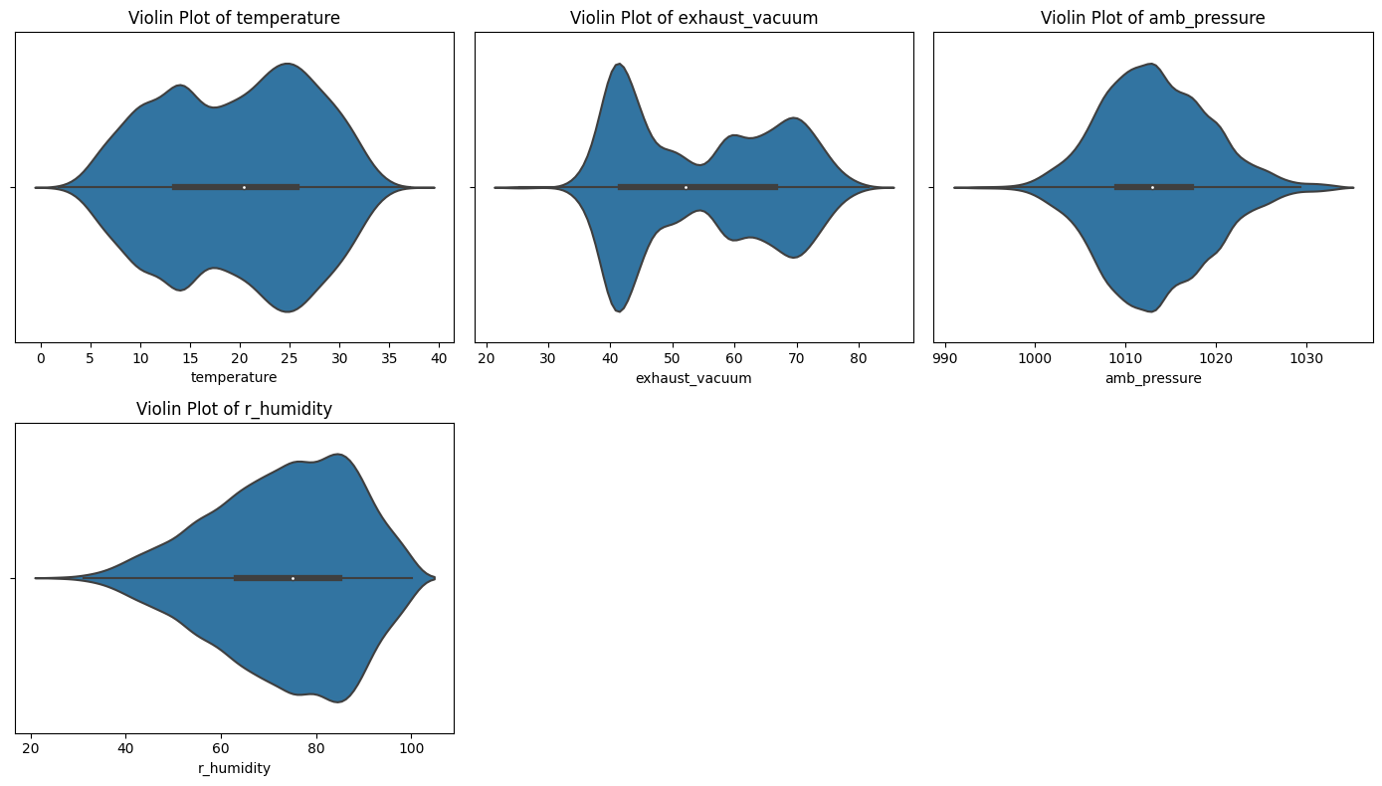
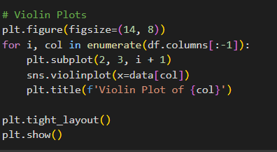
Violin Plots

Slide 12
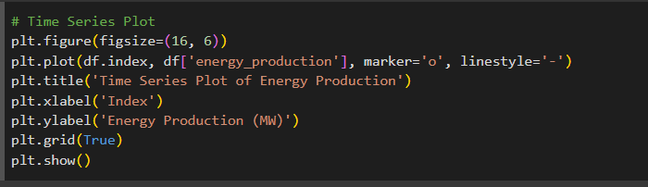
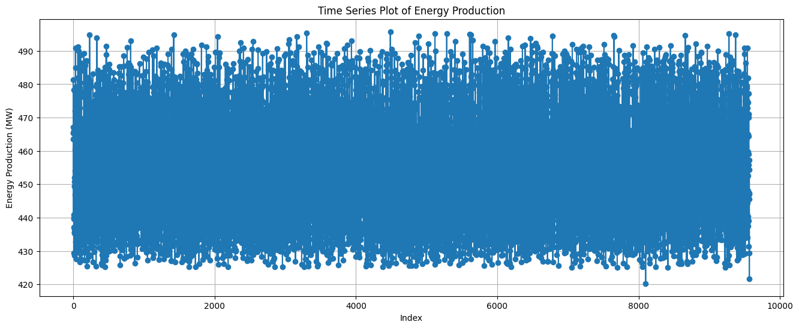
Time Series Plot

Slide 13
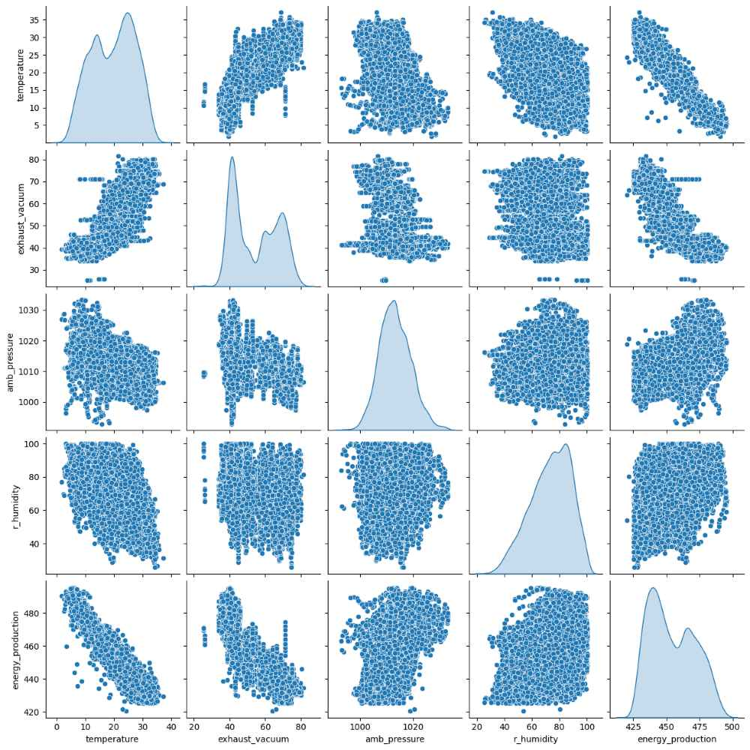
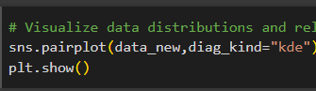
Scatter Plots
Scatter plots help to assess the relationship between two variables
A clear pattern can indicate the nature and strength of correlation
It shows relationship between variables,identifying outliers and gaining an over visual understanding of the structure of the data

Slide 14
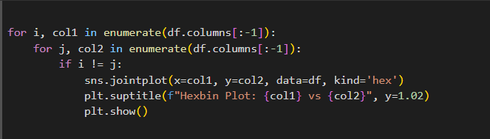
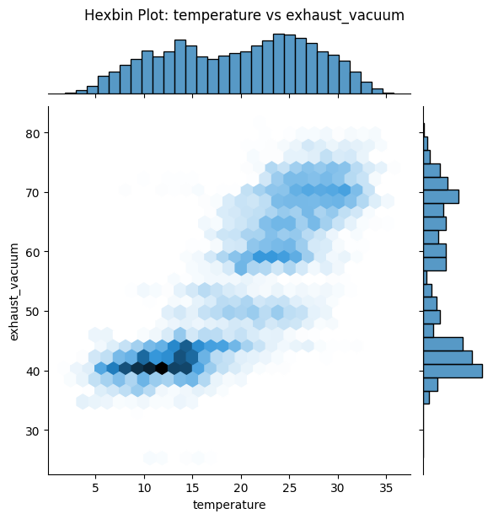
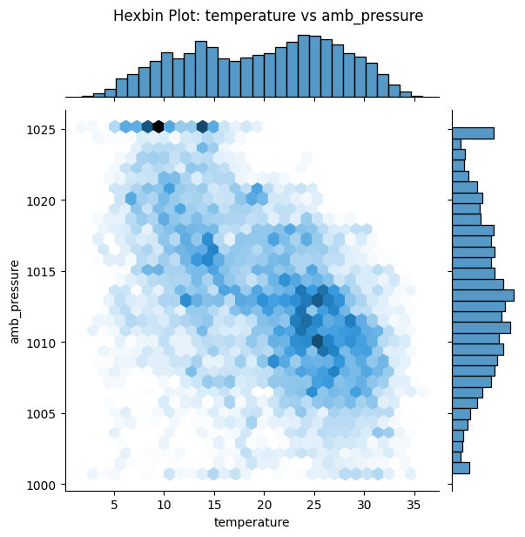
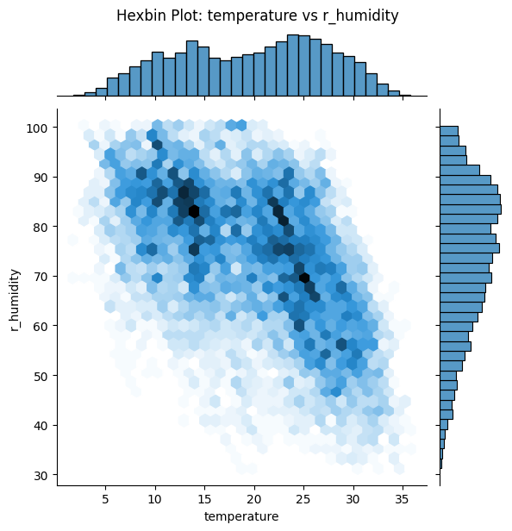
Hexbin Plots for all pairs of variables

Slide 15
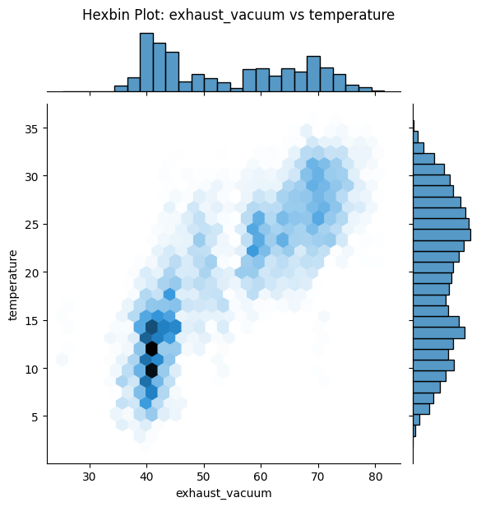
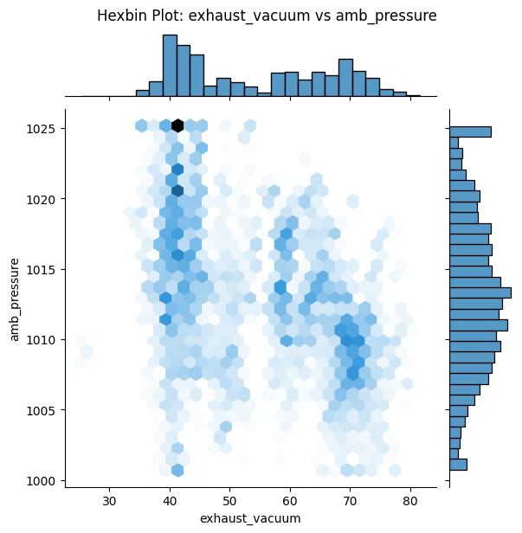
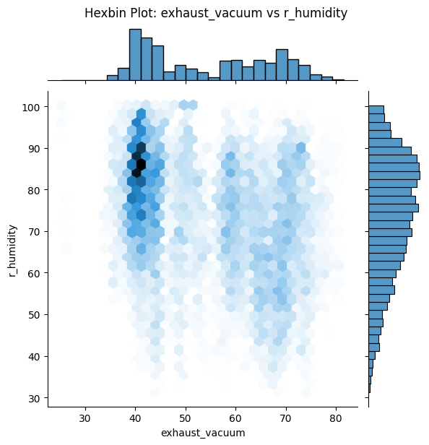
Exhaust_vaccum vs all 3 variables

Slide 16
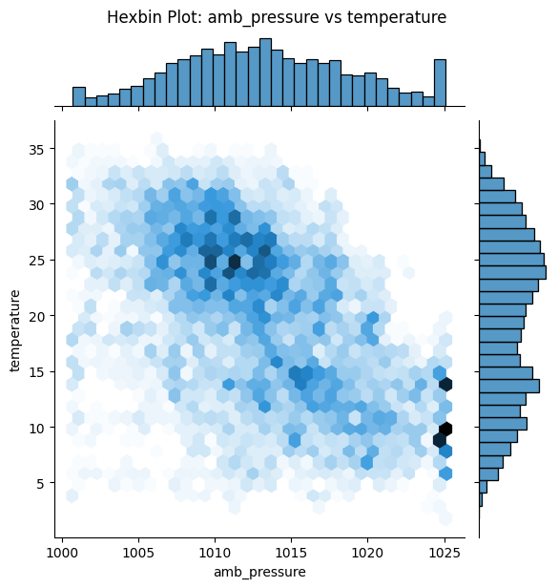
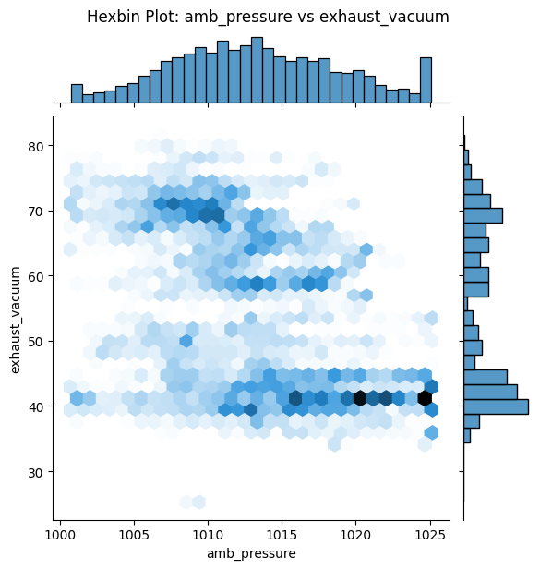
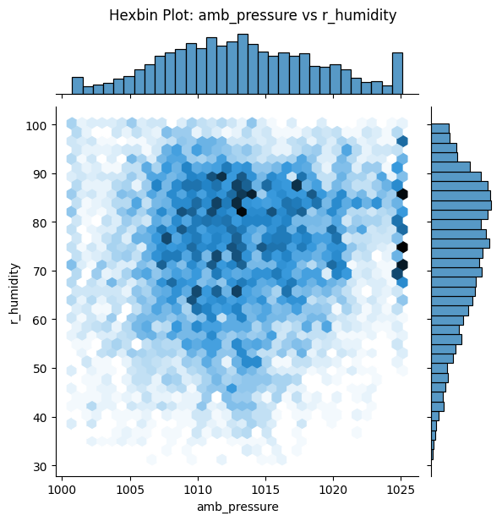
amb_pressure vs all 3 variables

Slide 17
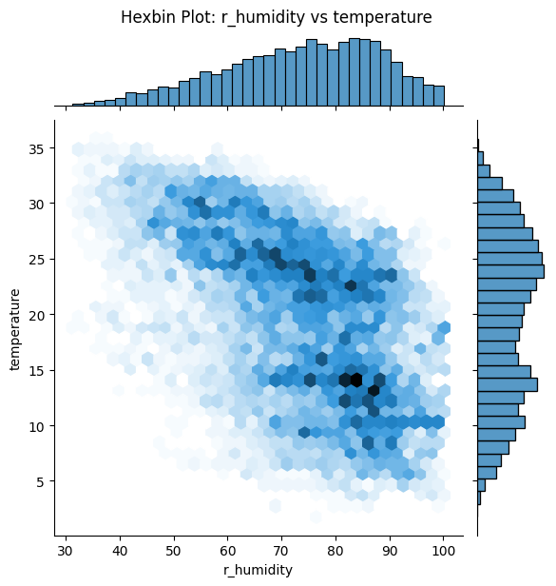
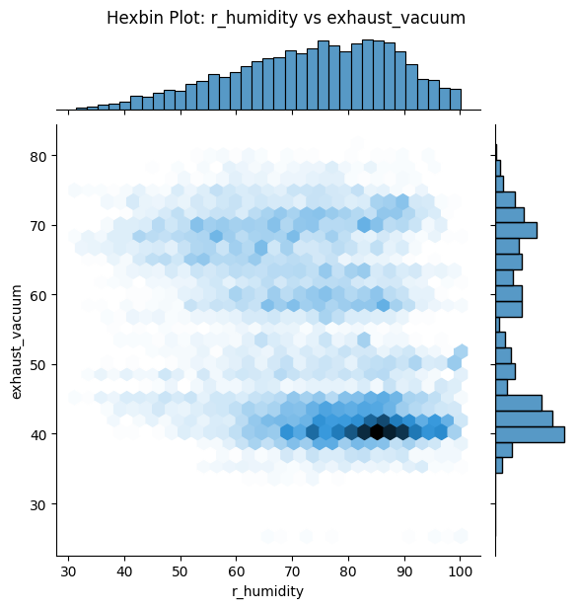
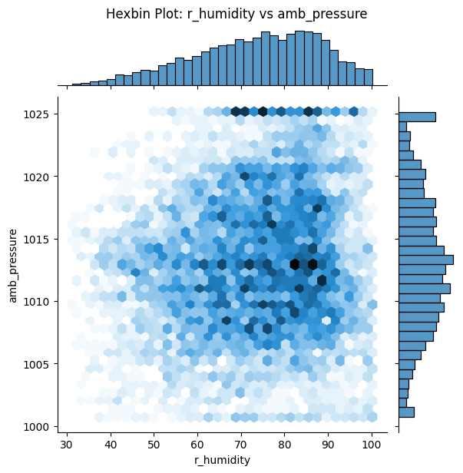
r_humidity vs all 3 variables

Slide 18
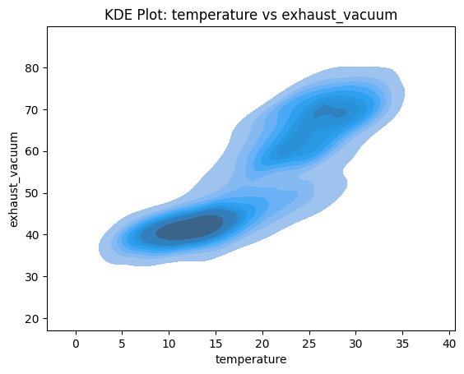
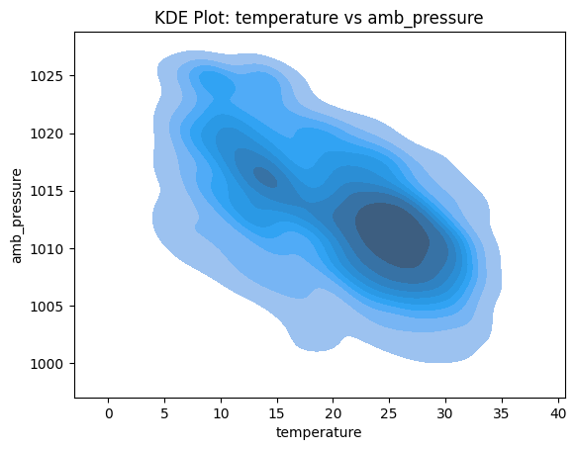
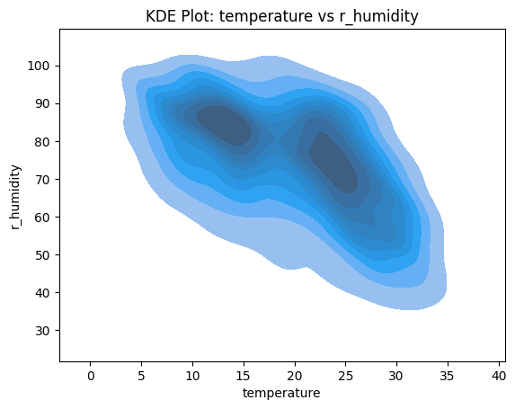
KDE Plots for all pairs of variables:
KD plots are particularly useful when we want a smooth representation of the data distribution without assuming a specific parametric form .

Slide 19
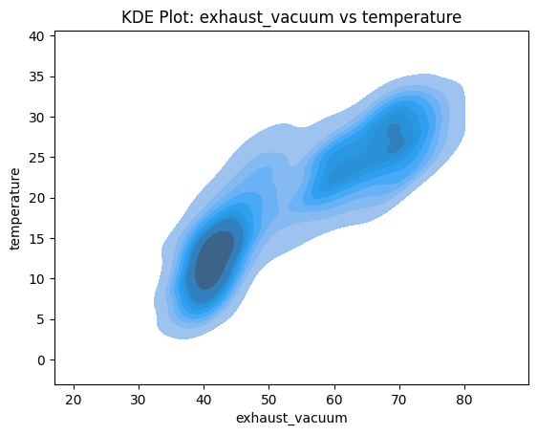
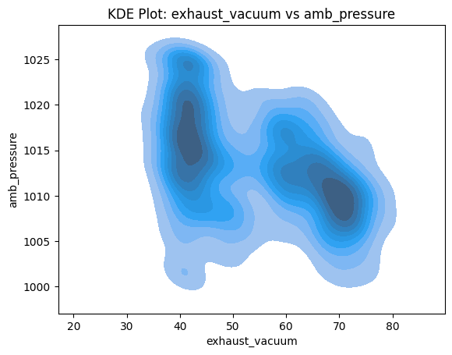
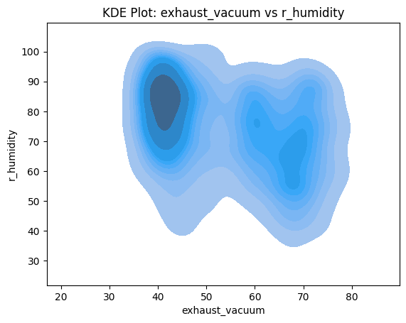
Exhaust_vaccum vs
all 3 variables

Slide 20
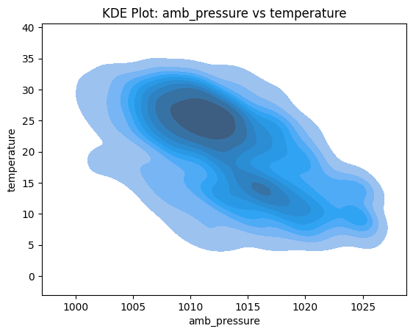
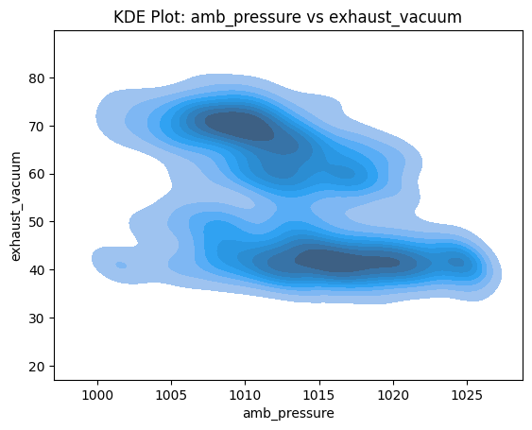
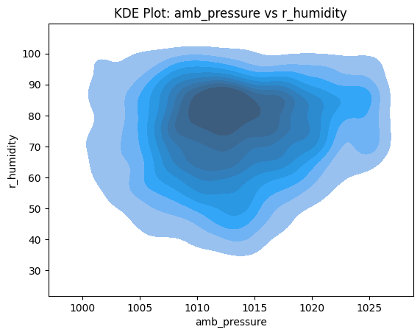
amb_pressure vs all 3 variables

Slide 21
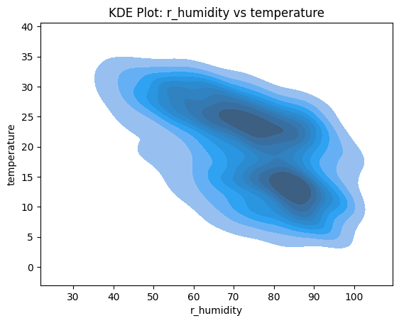
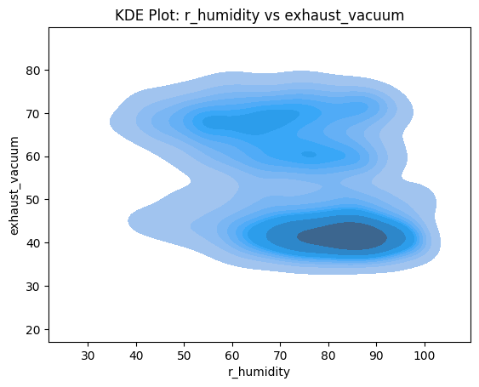
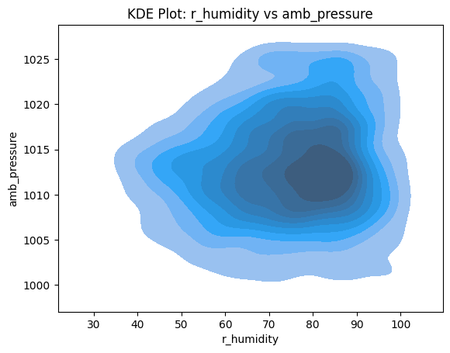
r_humidity vs all 3 variables

Slide 22
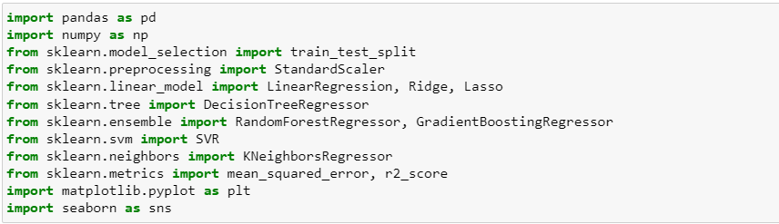
Import all the libraries required for the regression model

Slide 23
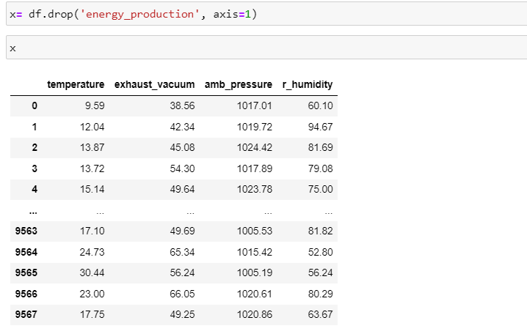
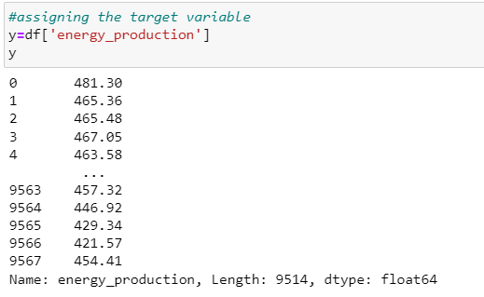
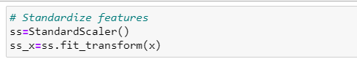
Data Preparation:
By the business objective by the client we choose the target variable as “Energy production”
assigning the target variable
assigning the “X” variable
standardizing them to ensure a consistent scale for analysis.

Slide 24
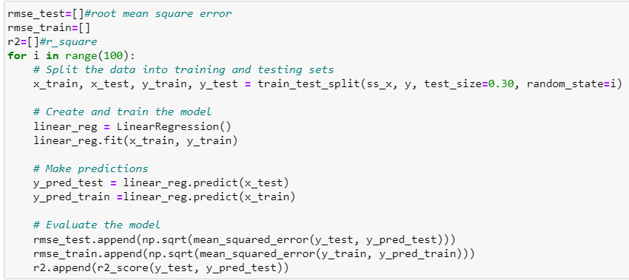
Model Evaluation:
Linear regression
RMSE- root mean square error
R2_score
Spliting the data for training and testing for linear regression model

Slide 25
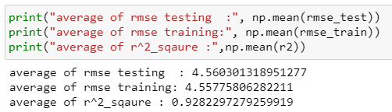
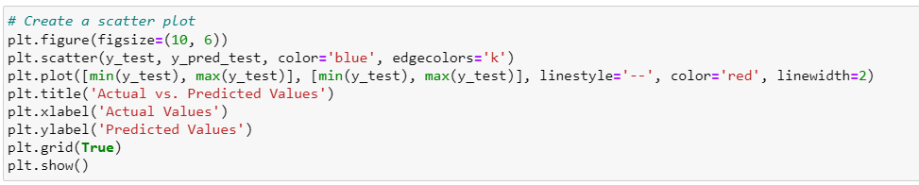
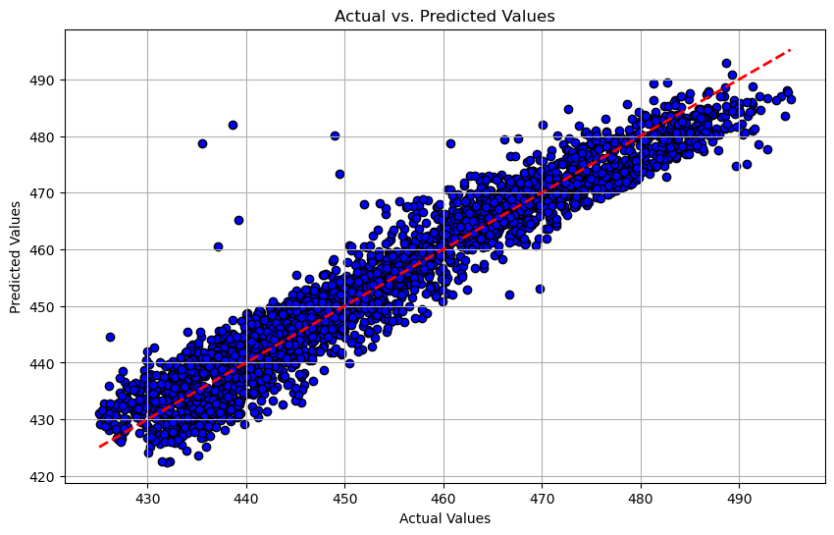
Therefore, the linear regression model predicts
with 92.8% accuracy
Scatter plot – Actual vs Predicted values

Slide 26
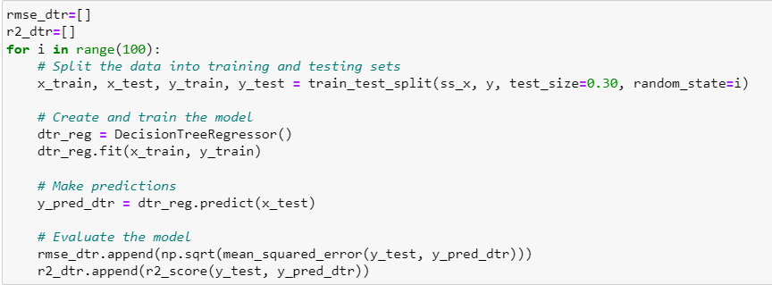
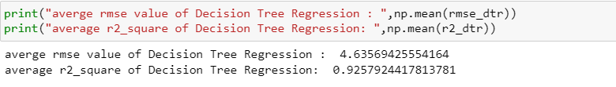
Decision Tree Regression:
The model is fitted with Decision Tree Regressor
Therefore, the Decision Tree regression model predicts
with 92.8% accuracy

Slide 27


scatter plot for Decision tree regressor

Slide 28


Gradient Boosting Regression(gb)
The model is fitted with Gradient Boosting Regression
Therefore, the Gradient Boosting Regression model predicts
With 94.7% accuracy

Slide 29



Scatter plot:

Slide 30

Support Vector Regression(svr)
Therefore, the Support Vector Regression model predicts
With 92.7% accuracy

Slide 31


scatter plot

Slide 32


K-Nearest Neighbors Regression
Therefore, the K-Nearest Neighbors Regression model predicts
With 94.8% accuracy

Slide 33

scatter plot

Slide 34

Random Forest Regressor
Therefore, the Random Forest Regressor model predicts
With 96.0% accuracy

Slide 35

scatter plot

Slide 36

Comparing the all models and choose the best one for prediction
Random Forest as the most suitable model
It achieved the lowest RMSE (3.3627) and highest R-squared (0.9609), indicating superior predictive power compared to other models.

Slide 37
Deployment using streamlit

Slide 38

Prediction deployment based upon the test data
Prediction energy production is 460.34MW

Slide 39
Challenges Faced:
1) while we are doing the exploratory data analysis part we noticed the presence of some outliers in ‘r_humidity’ and ‘amp_pressure’ columns.
2) plenty of duplicated data is present in the dataset.This may cause false prediction
3) We faced the challenges to determine the best accuracy for the model building.
How we overcome the challenges:
1) we used ‘Winzorizing’ method to treat the outliers.Winzorizing is the method involves replacing extreme values with a specific threshold value.This limits the influence of outliers without removing them completly.
2) deleted the duplicated data using the drop method
3) We resolved the accuracy of the model with the help of training and testing dataset by using the 6 different algoritms . And we choose the model with high R-squared value and less RMSE value for best model predictions

Slide 40
Thank you!

